Slide 1
Low spatial resolution
High temporal resolution and data throughput
Multiple trenches multiple times
Low temporal resolution
High spatial resolution and data throughput
Multiple trenches in detail once
Low data throughput
High spatial resolution and temporal resolution
Few trenches multiple times in good detail

Slide 2
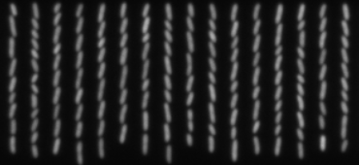
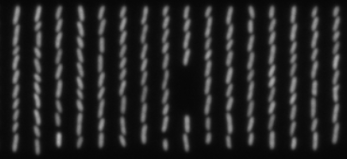
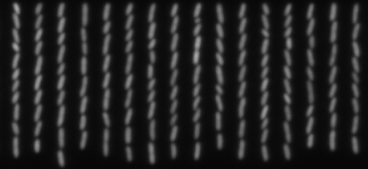
Low spatial resolution

Slide 3
Low temporal resolution

Slide 4
Low data throughput

Slide 5
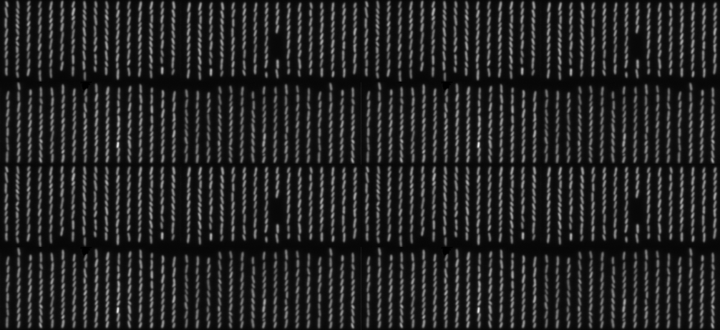
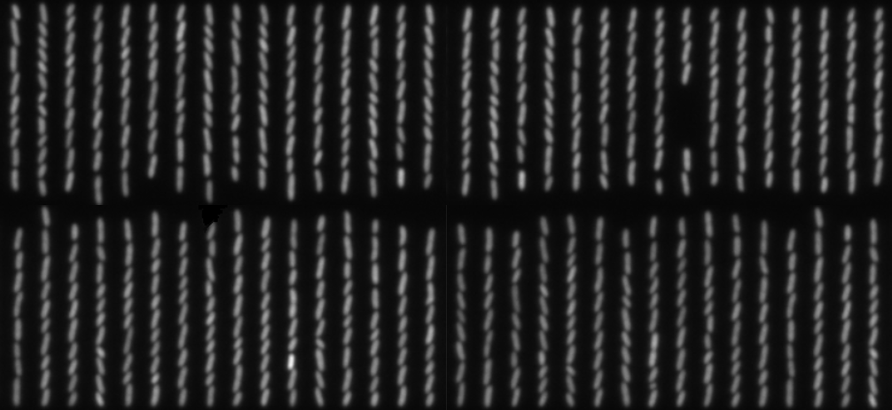
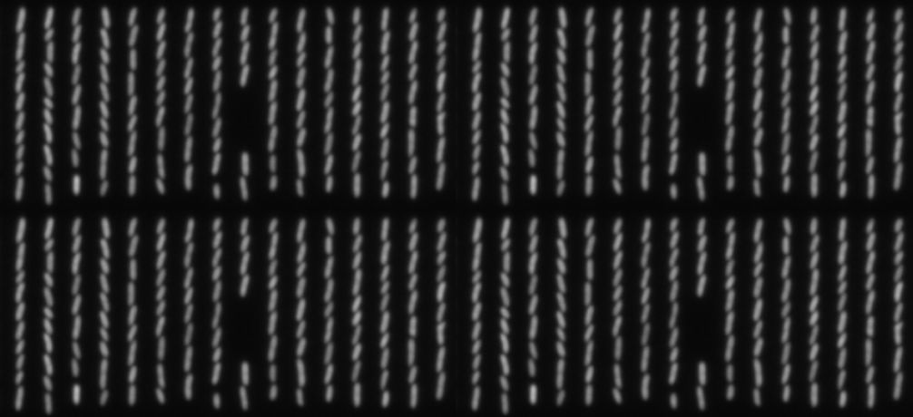
Spatial Resolution
Data Throughput
Temporal Resolution
Low Spatial Resolution
Low Temporal Resolution
Low Data Throughput

Slide 6
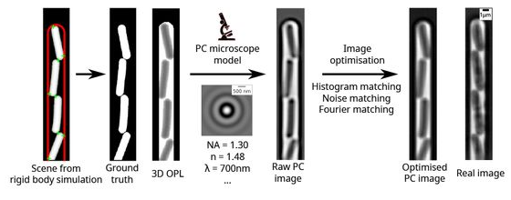

Slide 7


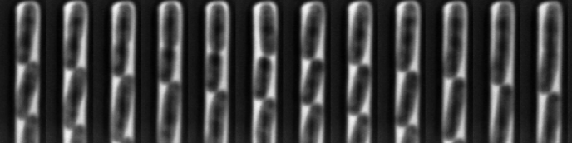













Slide 8
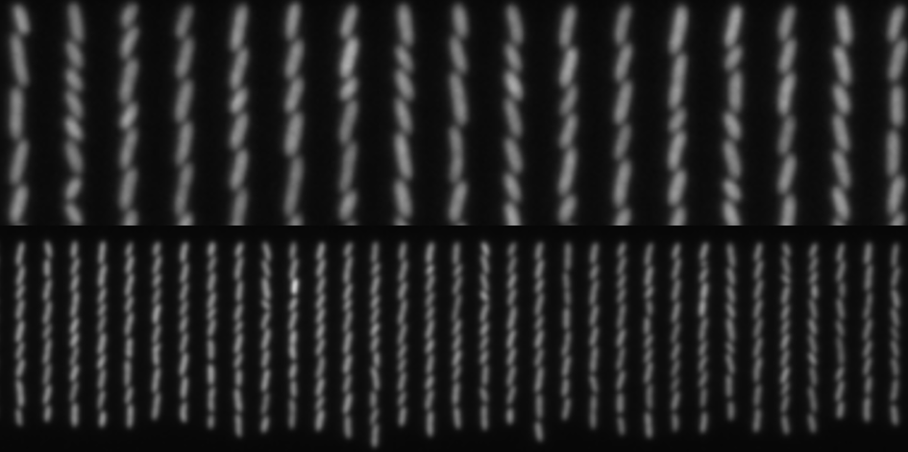
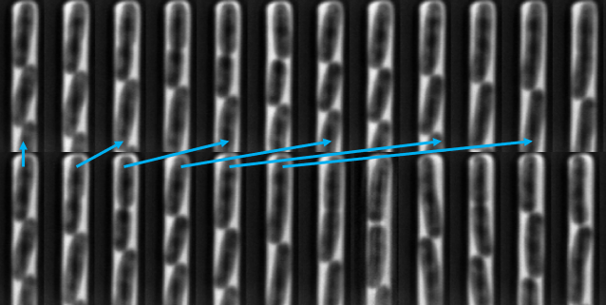
Varying Spatial Resolution
Varying Temporal Resolution
Spatial Resolution
Data Throughput
Temporal Resolution

